Slide 1

CSCI203 - Algorithms and Data Structures
Tutorial / Laboratory 1a
sjapit@uow.edu.au
9 July 2020

Slide 2
Algorithm Analysis
Other than speed, what other measures of efficiency might one use in a real-world setting?
Two kinds of algorithm efficiency:
Time (speed) efficiency, and
Space efficiency.
Time efficiency indicates how fast the algorithm runs (the number of times the basic steps or operations are executed.)
Space efficiency deals with the extra space it requires.

Slide 3
Algorithm Analysis
But how?
For speed efficiency, we usually measures the number of basic steps needed to complete a task. We will then associate this number with mathematical functions and analyse the efficiency based on the behaviour of the mathematical function.
For space efficiency, we measures how much space (mainly the main memory and stack space) are needed to complete a task. Similarly we will associate the number with mathematical function and analyse the efficiency based on the behaviour of the function.

Slide 4
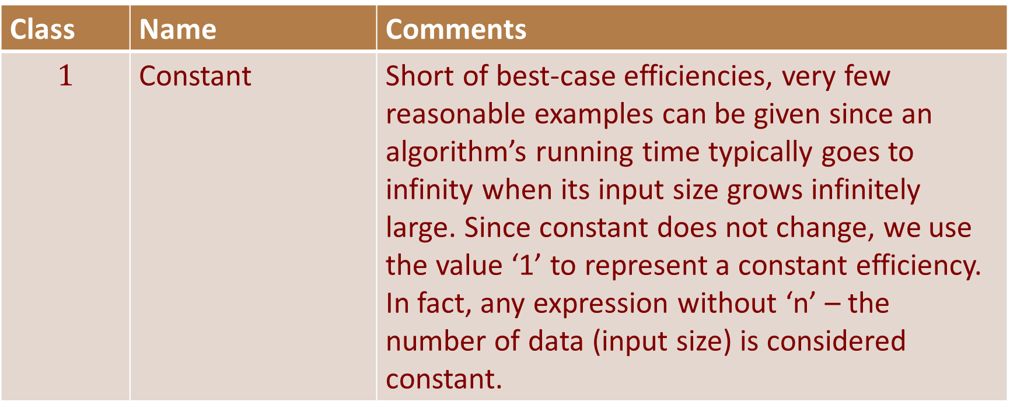
Classes of Functions
What are the functions that are important for analysis of algorithms discussed during lecture?
Class | Name | Comments
$$1$$ | Constant | Short of best-case efficiencies, very few reasonable examples can be given since an algorithm’s running time typically goes to infinity when its input size grows infinitely large. Since constant does not change, we use the value ‘1’ to represent a constant efficiency. In fact, any expression without ‘n’ – the number of data (input size) is considered constant.

Slide 5
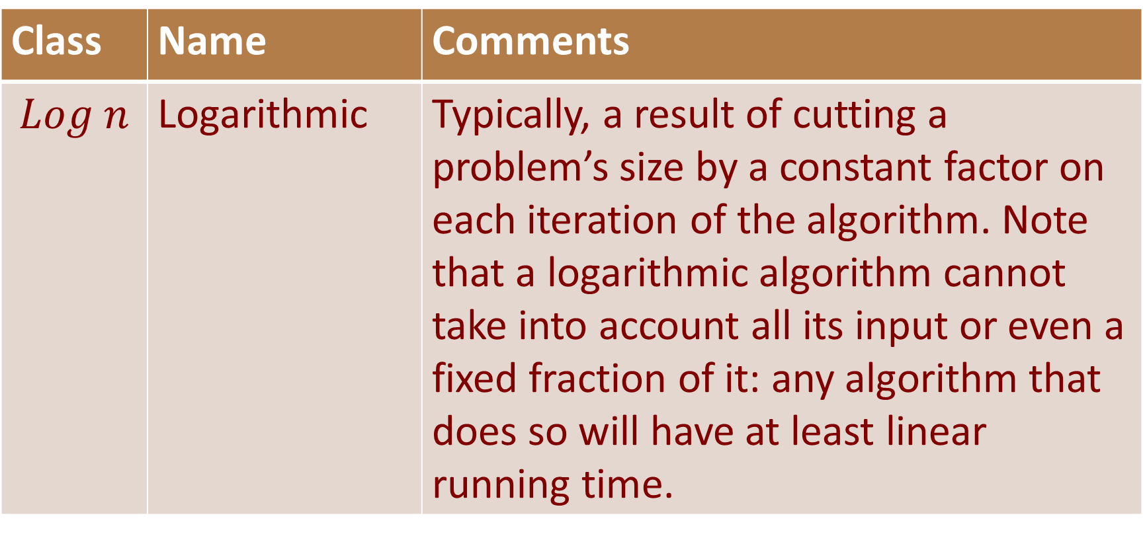
Classes of Functions
Class | Name | Comments
$$Log n$$ | Logarithmic | Typically, a result of cutting a problem’s size by a constant factor on each iteration of the algorithm. Note that a logarithmic algorithm cannot take into account all its input or even a fixed fraction of it: any algorithm that does so will have at least linear running time.

Slide 6
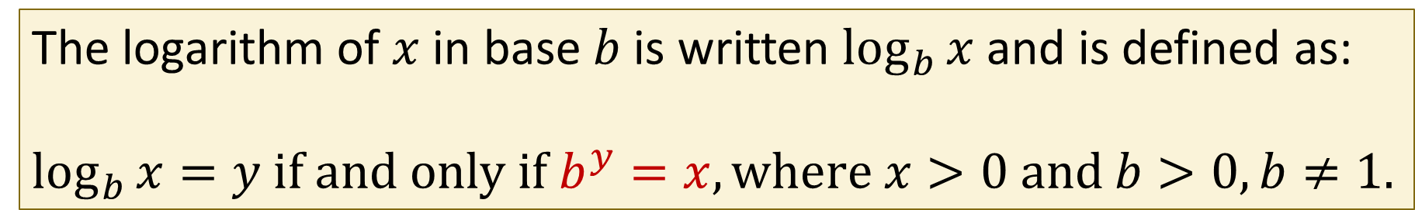
Classes of Functions
Definition of Logarithm (Revision)
The logarithm of $x$ in base $b$ is written $\log_{b}{x}$ and is defined as:
$\log_{b}{x}=y if and only if b^{y}=x, where x>0 and b>0, b≠1.$
$y=\log_{b}{x}$ means $b^{y}=x$

Slide 7
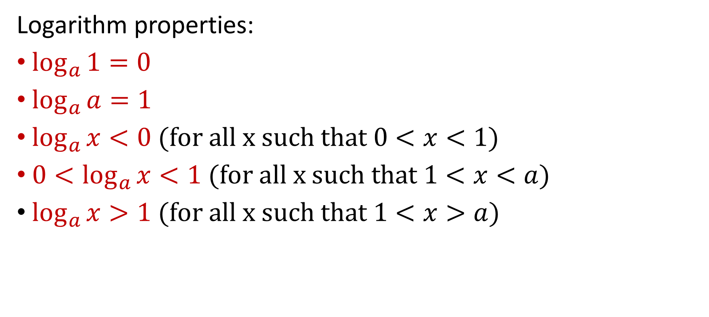
Classes of Functions
Logarithm properties:
$\log_{a}{1}=0$
$\log_{a}{a}=1$
$\log_{a}{x}<0 (for all x such that 0<x<1)$
$0<\log_{a}{x}<1 (for all x such that 1<x<a)$
$\log_{a}{x>1 (for all x such that 1<x>a)}$

Slide 8
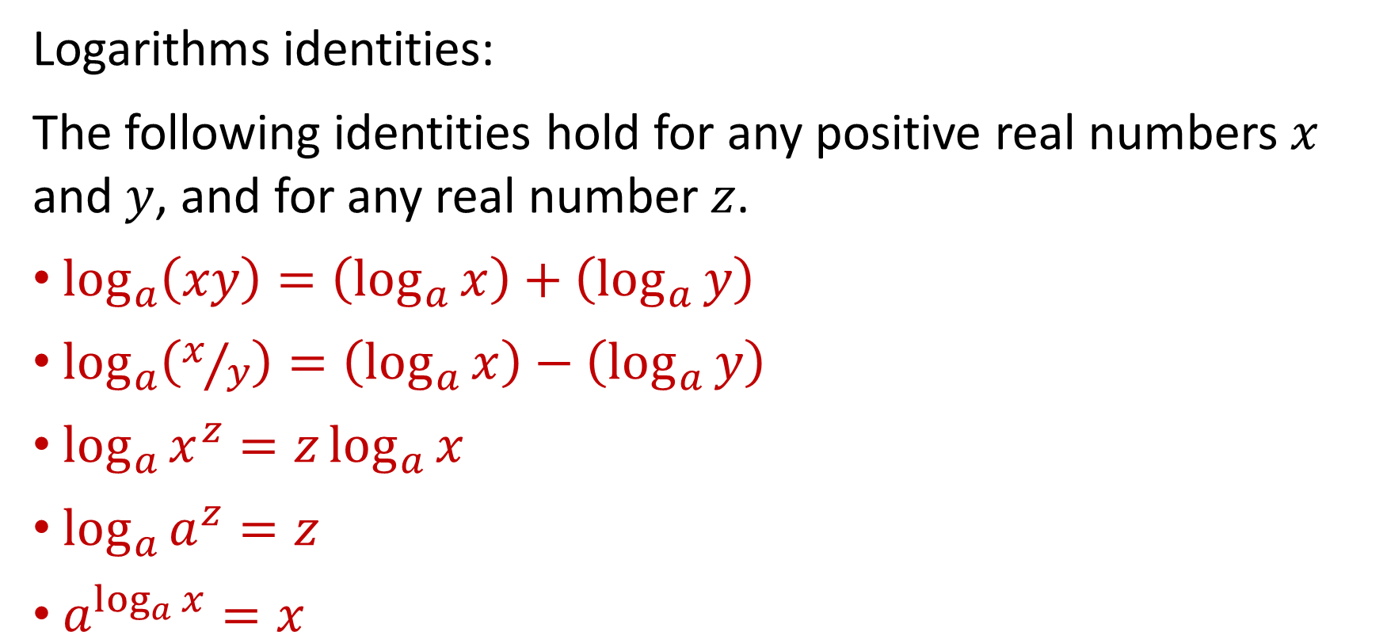
Classes of Functions
Logarithms identities:
The following identities hold for any positive real numbers $x$ and $y$, and for any real number $z$.
$\log_{a}\left(xy\right)=\left(\log_{a}{x}\right)+\left(\log_{a}{y}\right)$
$\log_{a}\left(x/y\right)=\left(\log_{a}{x}\right)−\left(\log_{a}{y}\right)$
$\log_{a}{x^{z}=z\log_{a}{x}}$
$\log_{a}{a^{z}}=z$
$a^{\log_{a}{x}}=x$

Slide 9
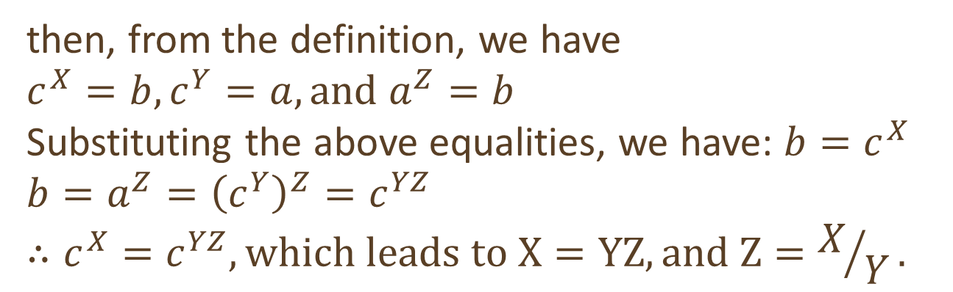

Classes of Functions
Useful theorem:
$$\log_{a}{b}=\frac{\log_{c}{b}}{\log_{c}{a}}, where a,b,c>0, and a≠1$$
Proof:
$$Let X=\log_{c}{b}$$
$$Y=\log_{c}{a}$$
$$Z=\log_{a}{b}$$
then, from the definition, we have
$$c^{X}=b, c^{Y}=a, and a^{Z}=b$$
Substituting the above equalities, we have: $b=c^{X}$
$$b=a^{Z}={\left(c^{Y}\right)}^{Z}=c^{YZ}$$
$$∴c^{X}=c^{YZ}, which leads to X=YZ, and Z=X/Y.$$

Slide 10

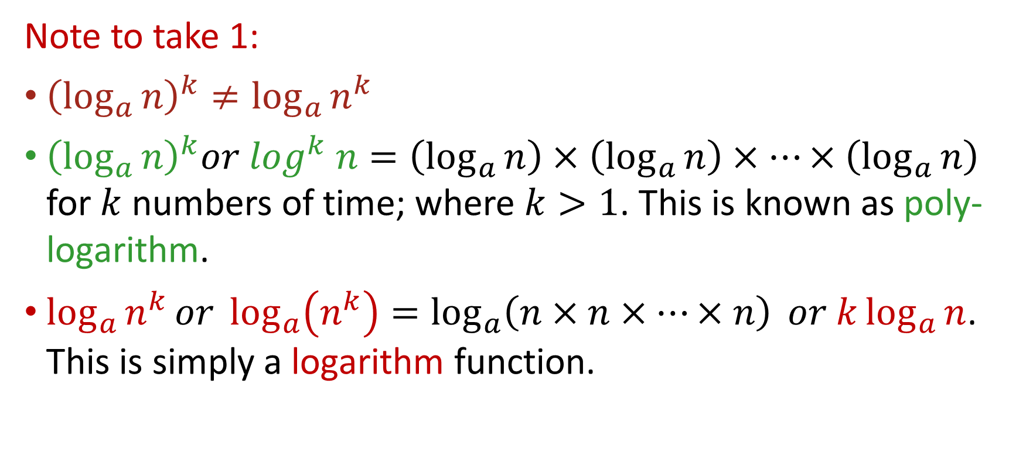
Classes of Functions
Note to take 1:
${\left(\log_{a}{n}\right)}^{k}≠{\log_{a}{n}}^{k}$
${\left(\log_{a}{n}\right)}^{k}or \log^{k} n=\left(\log_{a}{n}\right)×\left(\log_{a}{n}\right)×⋯×\left(\log_{a}{n}\right)$ for $k$ numbers of time; where $k>1$. This is known as poly-logarithm.
${\log_{a}{n}}^{k}or \log_{a}\left(n^{k}\right)=\log_{a}\left(n×n×…×n\right) or k\log_{a}{n}$. This is simply a logarithm function.
$$k times$$

Slide 11
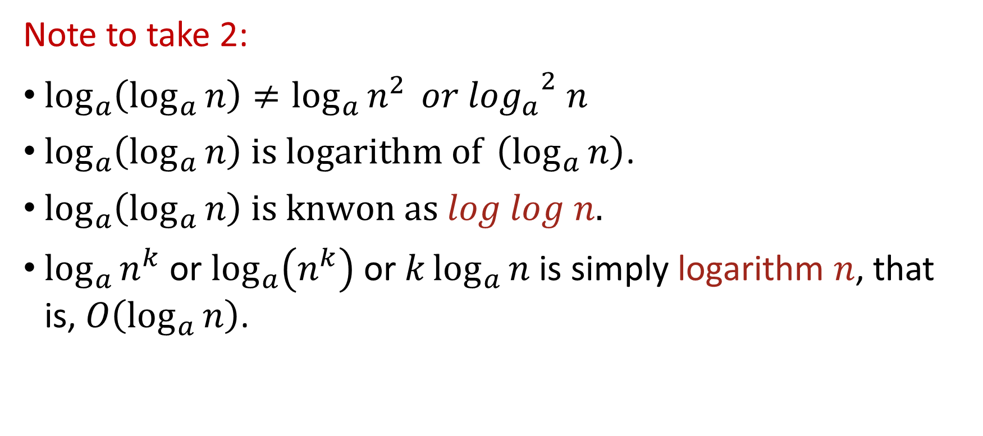
Classes of Functions
Note to take 2:
$\log_{a}\left(\log_{a}{n}\right)≠{\log_{a}{n}}^{2} or {\log_{a}}^{2} n$
$\log_{a}\left(\log_{a}{n}\right) is logarithm of \left(\log_{a}{n}\right)$.
$\log_{a}\left(\log_{a}{n}\right) is knwon as log log n.$
${\log_{a}{n}}^{k}$ or $\log_{a}\left(n^{k}\right)$ or $k\log_{a}{n}$ is simply logarithm $n$, that is, $O\left(\log_{a}{n}\right)$.

Slide 12
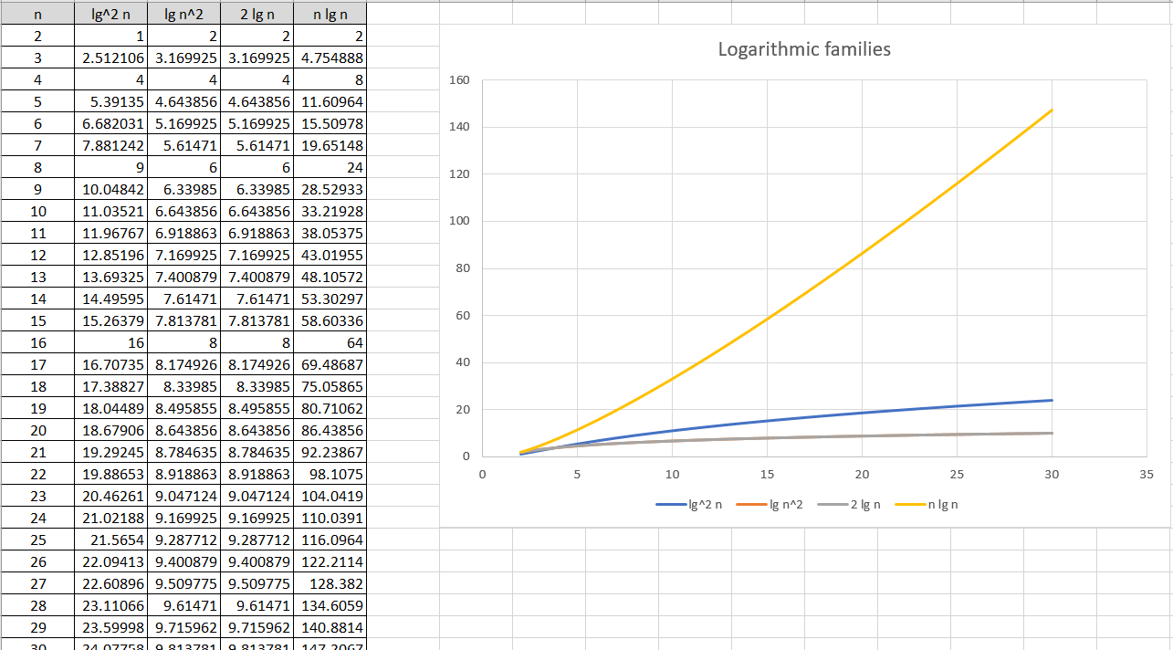

Slide 13
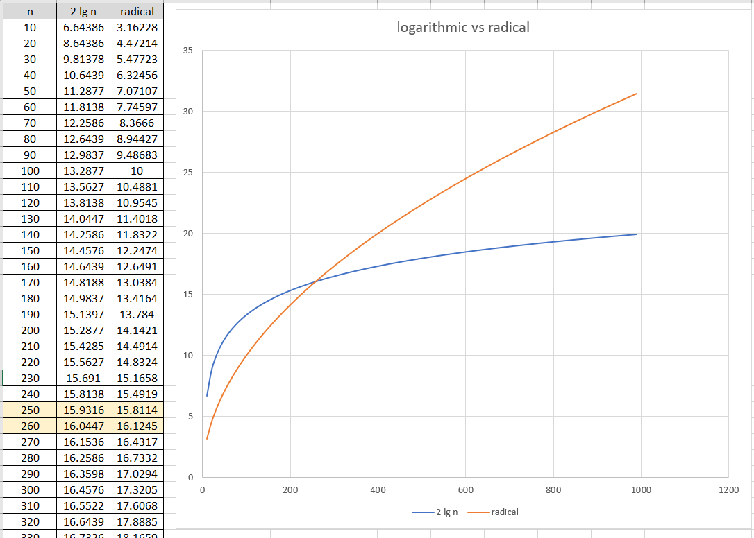

Slide 14
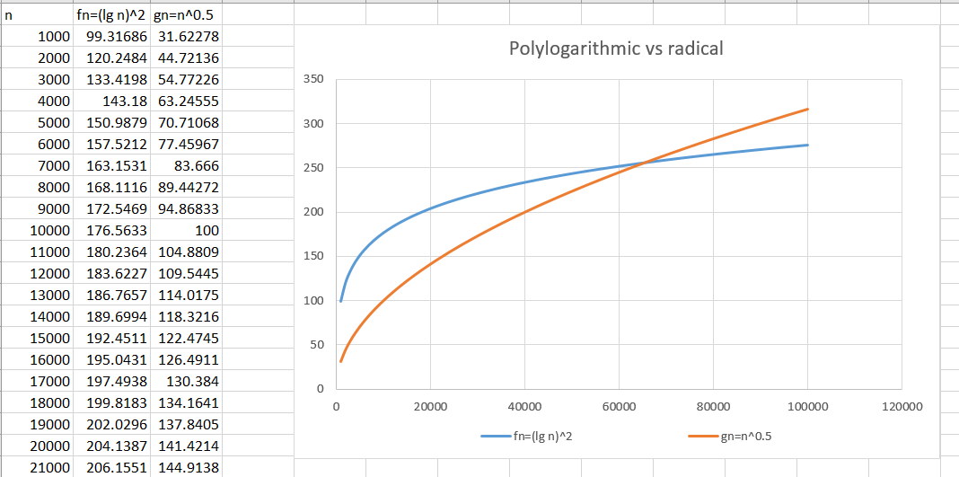

Slide 15
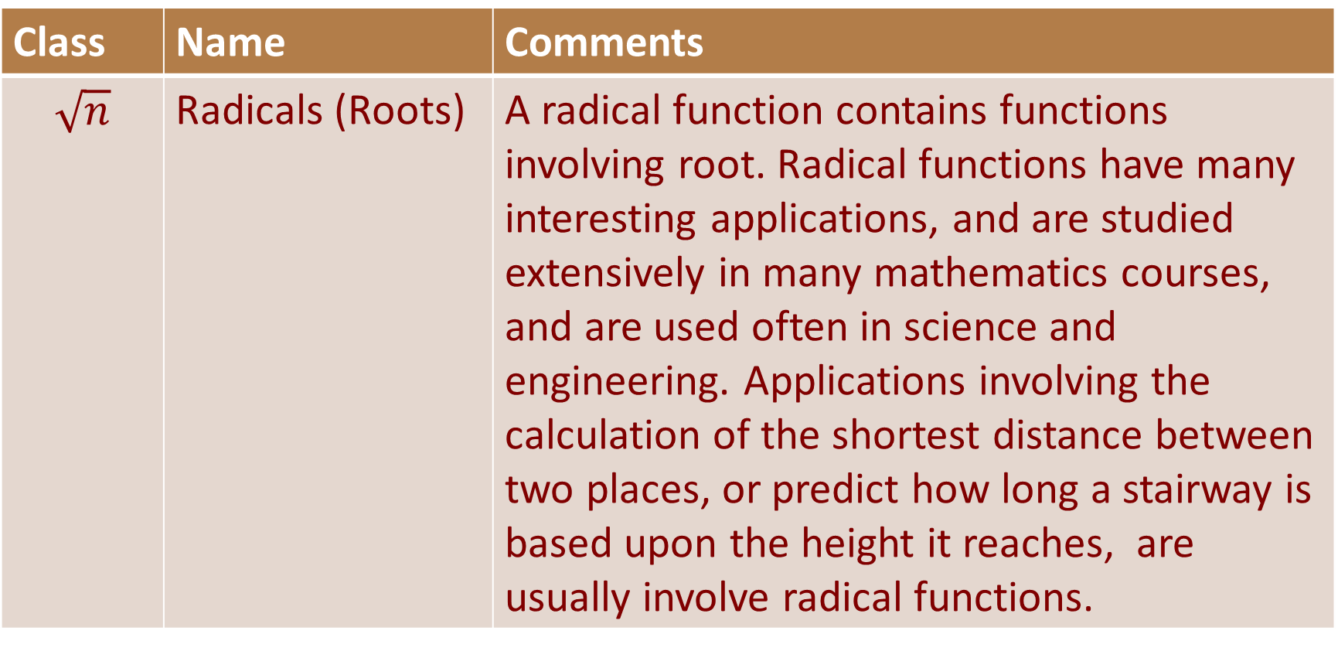
Classes of Functions
Class | Name | Comments
$$\sqrt{n}$$ | Radicals (Roots) | A radical function contains functions involving root. Radical functions have many interesting applications, and are studied extensively in many mathematics courses, and are used often in science and engineering. Applications involving the calculation of the shortest distance between two places, or predict how long a stairway is based upon the height it reaches, are usually involve radical functions.

Slide 16
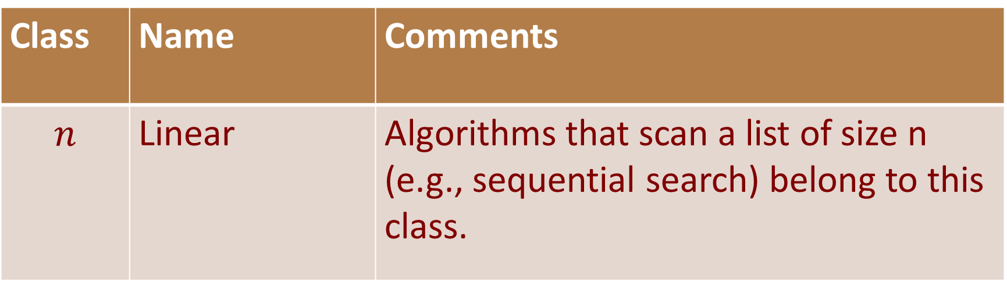
Classes of Functions
Class | Name | Comments
$$n$$ | Linear | Algorithms that scan a list of size n (e.g., sequential search) belong to this class.

Slide 17
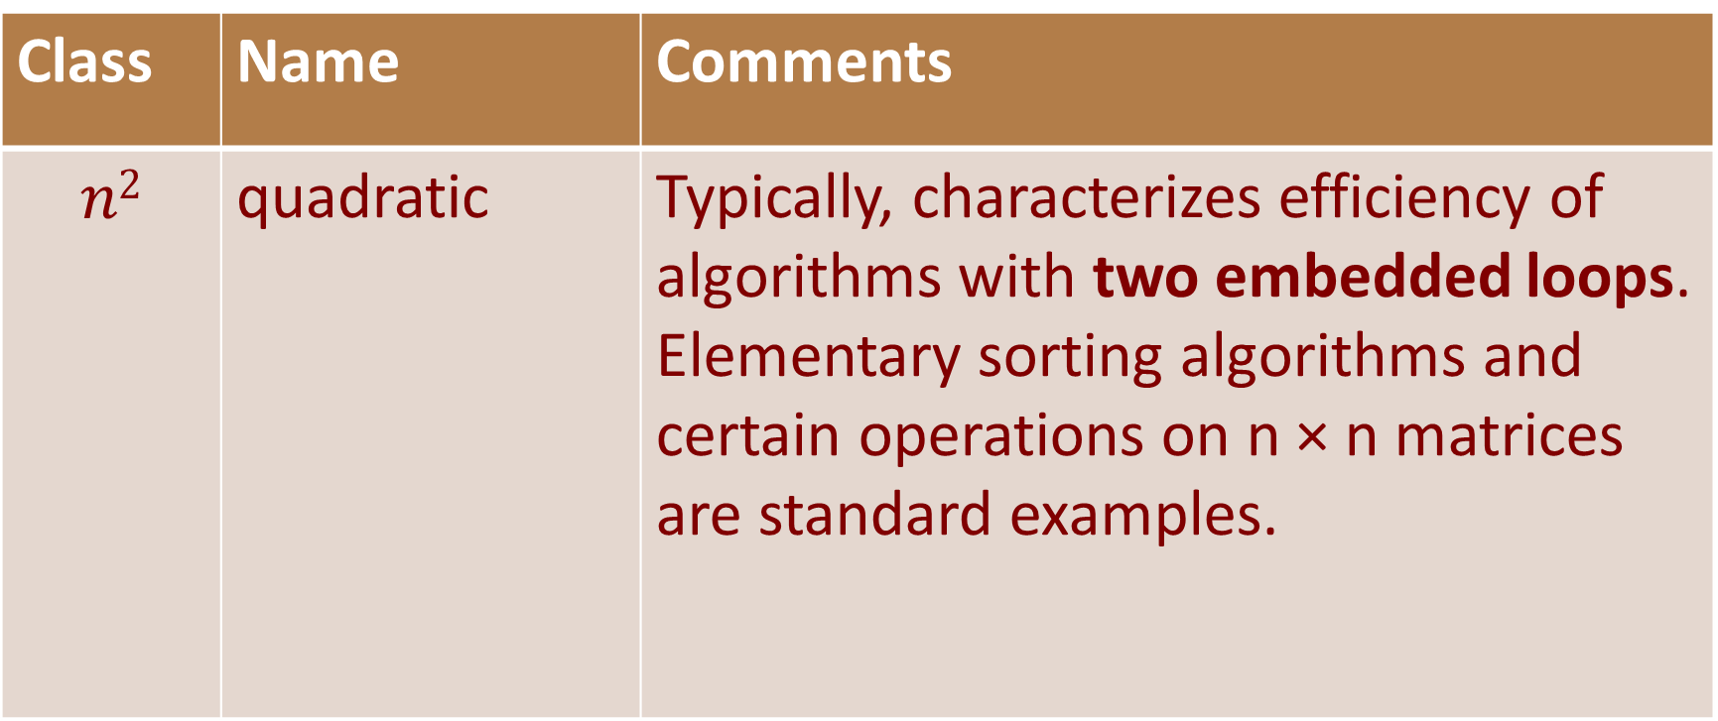
Classes of Functions
Class | Name | Comments
$$n2$$ | quadratic | Typically, characterizes efficiency of algorithms with two embedded loops. Elementary sorting algorithms and certain operations on n × n matrices are standard examples.

Slide 18
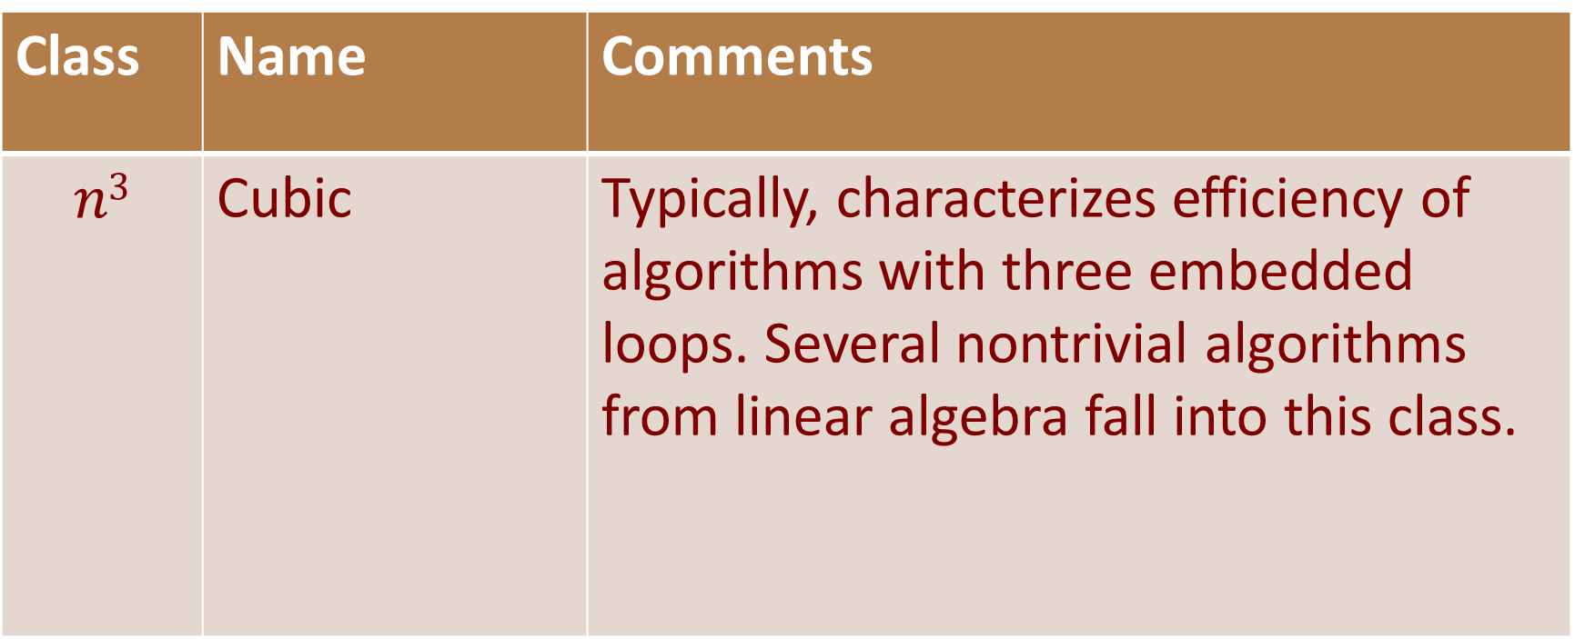
Classes of Functions
Class | Name | Comments
$$n3$$ | Cubic | Typically, characterizes efficiency of algorithms with three embedded loops. Several nontrivial algorithms from linear algebra fall into this class.

Slide 19
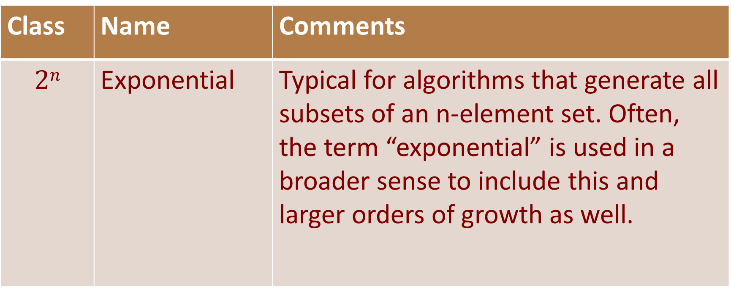
Classes of Functions
Class | Name | Comments
$$2n$$ | Exponential | Typical for algorithms that generate all subsets of an n-element set. Often, the term “exponential” is used in a broader sense to include this and larger orders of growth as well.

Slide 20
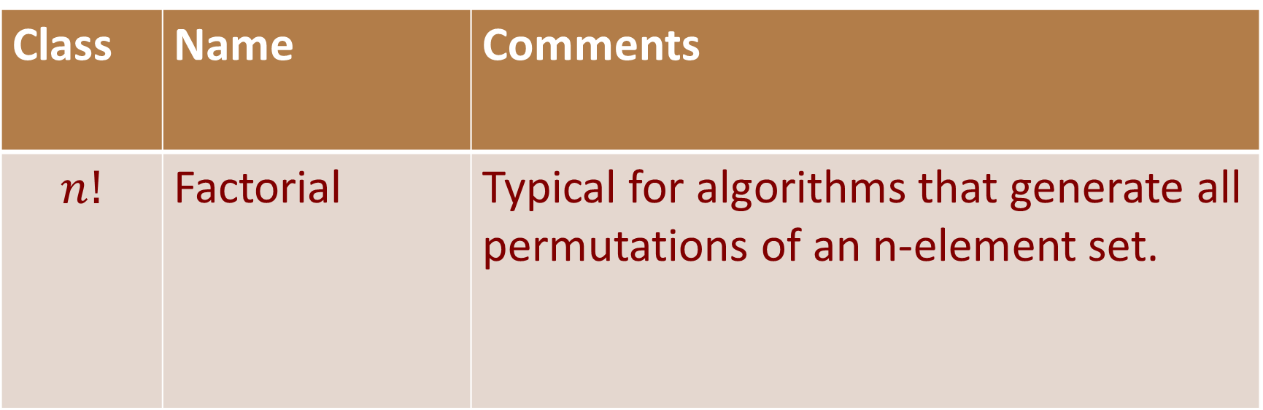
Classes of Functions
Class | Name | Comments
$$n!$$ | Factorial | Typical for algorithms that generate all permutations of an n-element set.

Slide 21
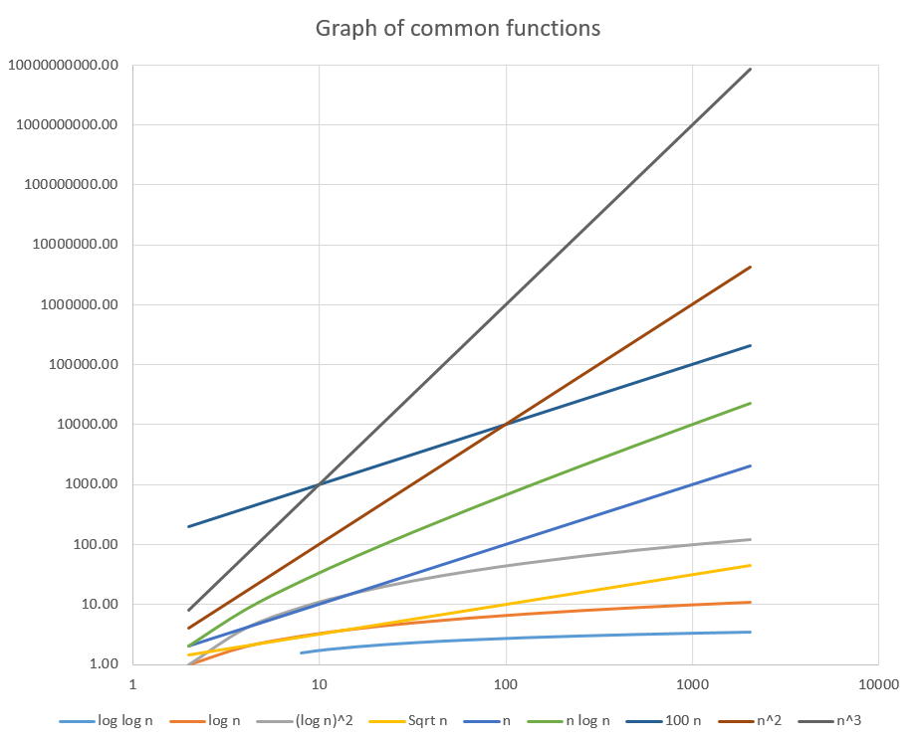
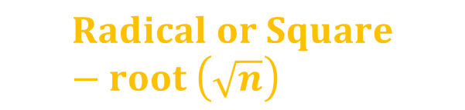








$$Cubic \left(n^{3}\right)$$
$$Quadratic \left(n^{2}\right)$$
$$linear (100 n)$$
$$Linearithmic \left(n\log{n}\right)$$
$$Linear \left(n\right)$$
$${\left(\lg{n}\right)}^{2}$$
$$Radical or Square−root \left(\sqrt{n}\right)$$
$$logarithm (log{n)}$$
$$Logarithm of log (log{\log{n})}$$

Slide 22
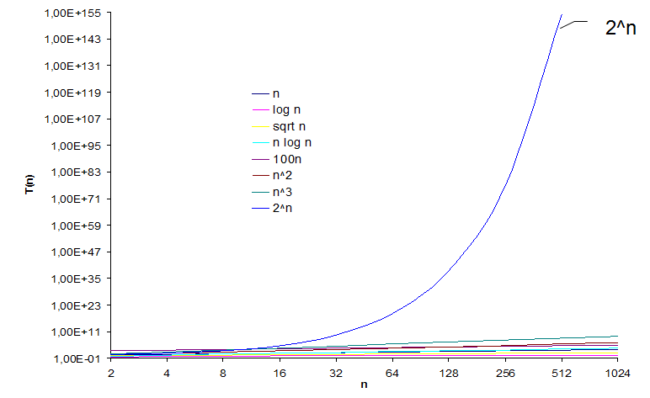
Classes of Functions

Slide 23
Classes of Functions
X | log n | sqrt n | n | nlogn | 100n | n² | n³ | 2^{n} | n!
1 | 0 | 1 | 1 | 0 | 100 | 1 | 1 | 2 | 1
2 | 0.30103 | 1.414214 | 2 | 0.60206 | 200 | 4 | 8 | 4 | 2
3 | 0.477121 | 1.732051 | 3 | 1.431364 | 300 | 9 | 27 | 8 | 6
4 | 0.60206 | 2 | 4 | 2.40824 | 400 | 16 | 64 | 16 | 24
5 | 0.69897 | 2.236068 | 5 | 3.49485 | 500 | 25 | 125 | 32 | 120
6 | 0.778151 | 2.44949 | 6 | 4.668908 | 600 | 36 | 216 | 64 | 720
7 | 0.845098 | 2.645751 | 7 | 5.915686 | 700 | 49 | 343 | 128 | 5040
8 | 0.90309 | 2.828427 | 8 | 7.22472 | 800 | 64 | 512 | 256 | 40320
9 | 0.954243 | 3 | 9 | 8.588183 | 900 | 81 | 729 | 512 | 362880
10 | 1 | 3.162278 | 10 | 10 | 1000 | 100 | 1000 | 1024 | 3628800

Slide 24
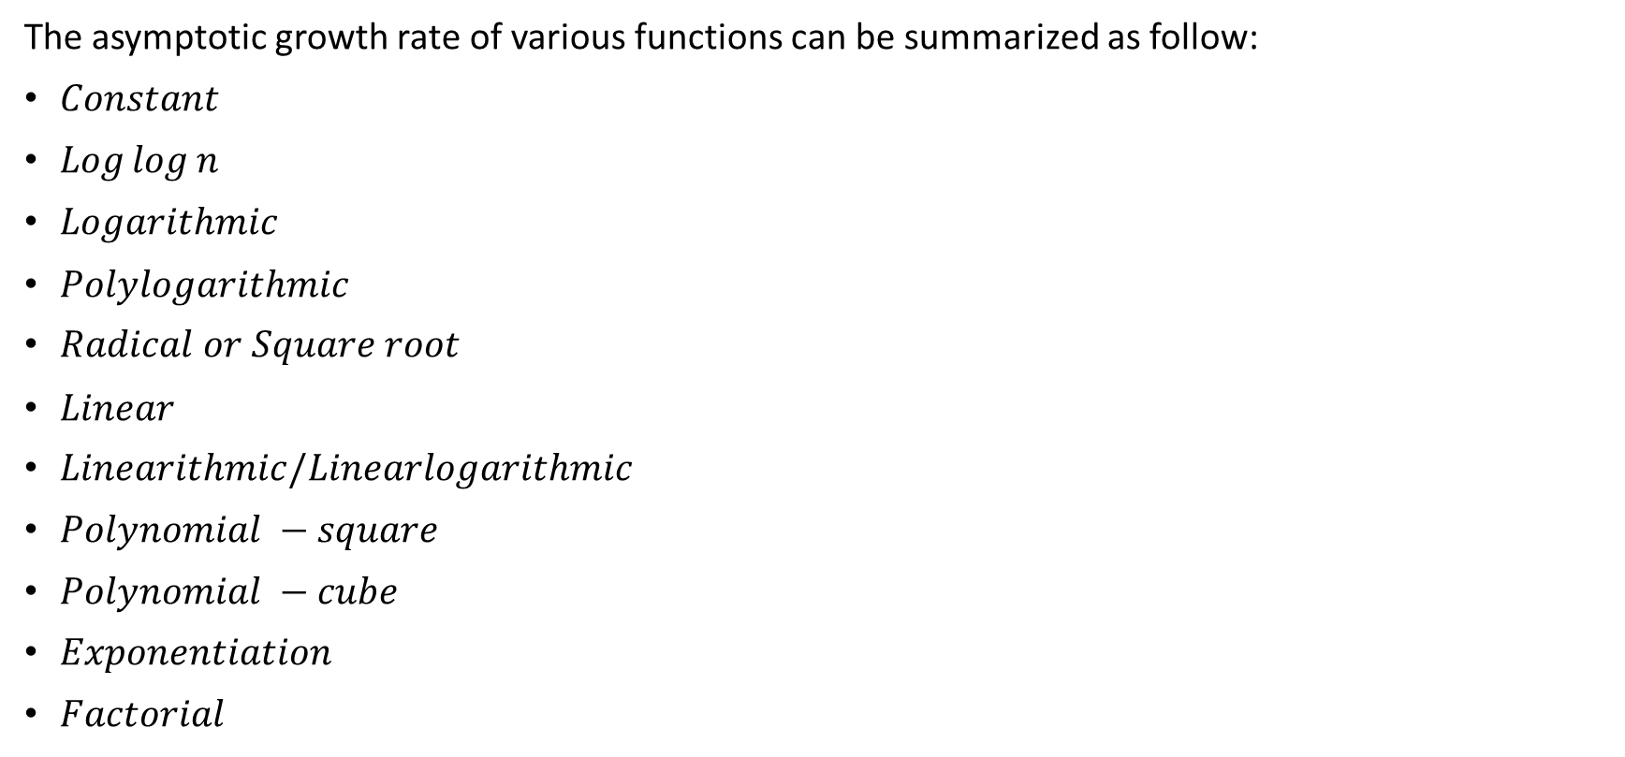
In conclusion
The asymptotic growth rate of various functions can be summarized as follow:
$Constant$
$Log⁡log⁡n$
$Logarithmic$
$Polylogarithmic$
$Radical or Square root$
$Linear$
$Linearithmic/Linearlogarithmic$
$Polynomial −square$
$Polynomial −cube$
$Exponentiation$
$Factorial$

Slide 25
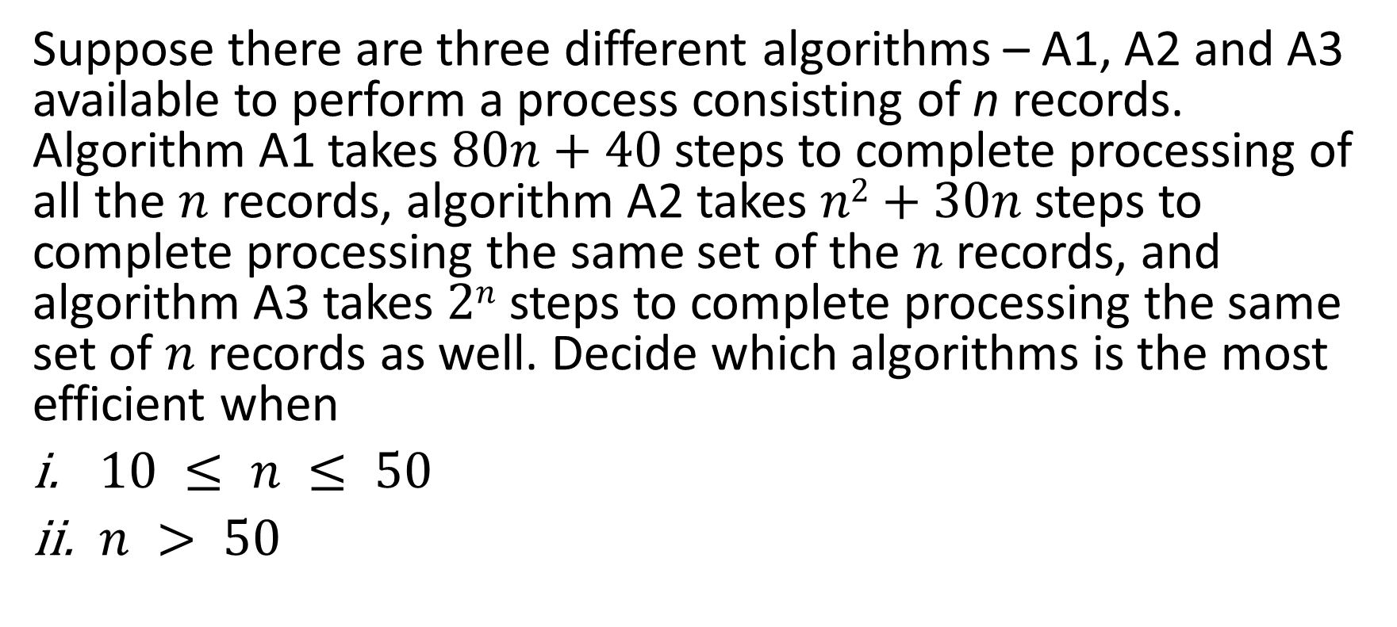
Algorithm Analysis - Example
Suppose there are three different algorithms – A1, A2 and A3 available to perform a process consisting of n records. Algorithm A1 takes $80n+40$steps to complete processing of all the $n$ records, algorithm A2 takes $n2+30n$steps to complete processing the same set of the $n$ records, and algorithm A3 takes $2n$ steps to complete processing the same set of $n$ records as well. Decide which algorithms is the most efficient when
$10 ≤ n ≤ 50$
$n > 50$

Slide 26

15 minutes to discuss

Slide 27
Algorithm Analysis - Example
When 10 ≤ n ≤ 50
Algorithm A2 provides best result, follows by algorithm A1 and algorithm A3. This is obvious as shown in the tabulation below:
Value of n | Algorithm A1 | Algorithm A2 | Algorithm A3
n = 10 | 80n + 40 800 + 40 840 | n² + 30n 100 + 300 400 | 2^{n} 2¹⁰ 1024
n = 50 | 80n + 40 4000 + 40 4040 | n² + 30n 2500 + 1500 4000 | 2^{n} 2⁵⁰ 1.125 × 10¹⁵
From the above, it is noted that when 10 ≤ n ≤ 50, algorithm A2 provides the best result among the three algorithms, follows by algorithm A1 and algorithm A3.

Slide 28
Algorithm Analysis - Example
When n > 50
Algorithm A1 provides the best result among the three algorithms, follows by algorithm A2 and algorithm A3. This is observed form the following table:
Value of n | Algorithm A1 | Algorithm A2 | Algorithm A3
n = 51 | 80n + 40 4080 + 40 4120 | n² + 30n 2601 + 1530 4131 | 2^{n} 2⁵¹ 2.252 x 10¹⁵
From the above, it is noted that when n > 50, algorithm A1 provides the best result among the three algorithms, follows by algorithms A2 and A3.

Slide 29

Algorithm Efficiency
Suppose we are comparing implementations of insertion sort and merge sort on the same machine. For inputs of size $n$, insertion sort runs in $8n2$ steps, while merge sort runs in $64n lg⁡n$ steps. For which values of $n$ does insertion sort perform better than merge sort?
15 minutes to discuss.

Slide 30
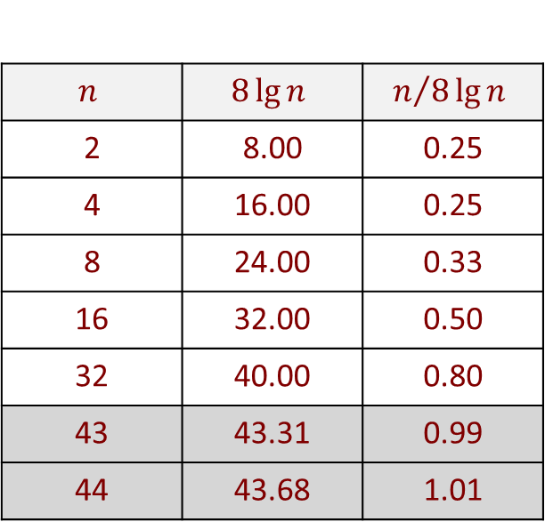
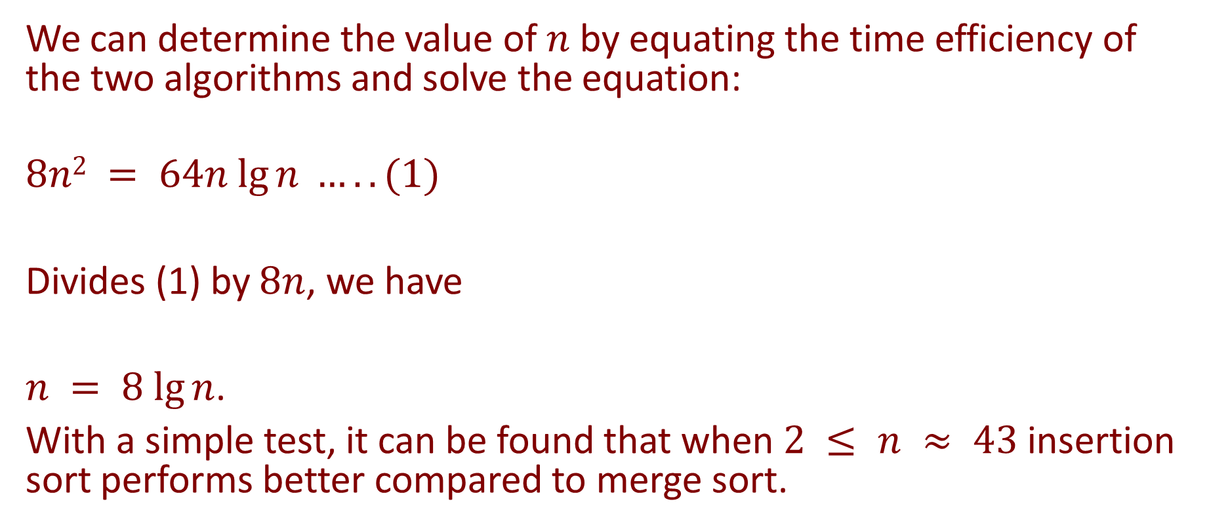
Algorithm Efficiency
We can determine the value of $n$ by equating the time efficiency of the two algorithms and solve the equation:
$$8n2 = 64n lg⁡n …..(1)$$
Divides (1) by $8n$, we have
$n = 8 lg⁡n$.
With a simple test, it can be found that when $2 ≤ n ≈ 43$insertion sort performs better compared to merge sort.
$$n$$ | $$8\lg{n}$$ | $$n/{8\lg{n}}$$
2 | 8.00 | 0.25
4 | 16.00 | 0.25
8 | 24.00 | 0.33
16 | 32.00 | 0.50
32 | 40.00 | 0.80
43 | 43.31 | 0.99
44 | 43.68 | 1.01

Slide 31

Algorithm Efficiency
Insertion Sort
$$n_{0}≈43$$

Slide 32
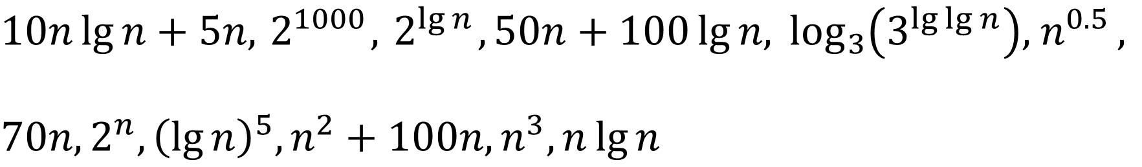
Classes of functions
Order the following functions by asymptotic growth rate.
$$10n\lg{n+5n, { 2}^{1000},{ 2}^{\lg{n}}, 50n+100\lg{n, \log_{3}\left(3^{\lg{\lg{n}}}\right), { n}^{0.5}, }}$$
$70n, 2^{n}, {\left(\lg{n}\right)}^{5}, n^{2}+100n, n^{3}, n\lg{n}$
15 minutes to discuss.

Slide 33
Classes of functions
To arrange the functions according to the growth rate of each, we can construct a table that lists the various function in order of their growth behaviour as follow:
Order | Function | E.g.,
1
2
3
… | … | …

Slide 34
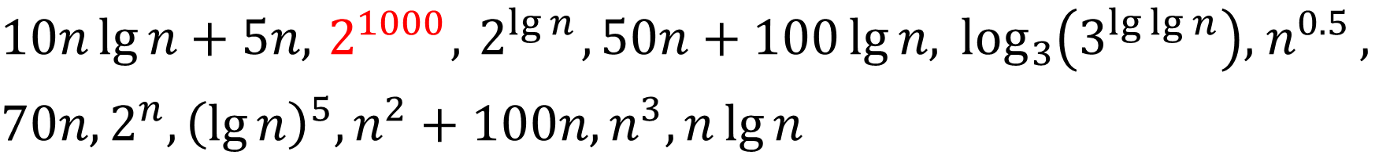
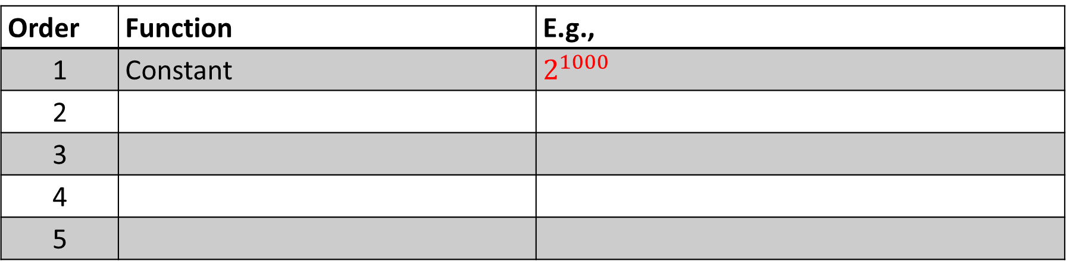
Classes of functions
$$10n\lg{n+5n, { 2}^{1000},{ 2}^{\lg{n}}, 50n+100\lg{n, \log_{3}\left(3^{\lg{\lg{n}}}\right), { n}^{0.5}, }}$$
$70n, 2^{n}, {\left(\lg{n}\right)}^{5}, n^{2}+100n, n^{3}, n\lg{n}$
Order | Function | E.g.,
1 | Constant | $$2^{1000}$$
2
3
4
5

Slide 35
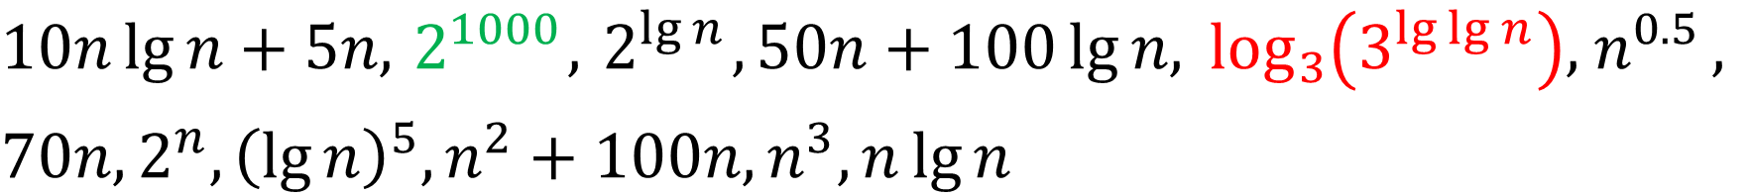
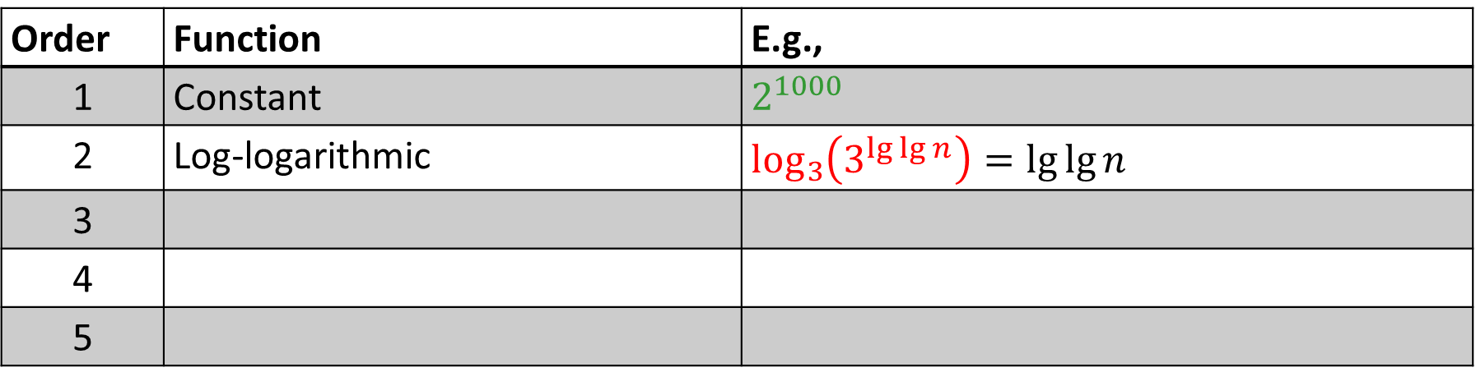
Classes of functions
$$10n\lg{n+5n, { 2}^{1000},{ 2}^{\lg{n}}, 50n+100\lg{n, \log_{3}\left(3^{\lg{\lg{n}}}\right), { n}^{0.5}, }}$$
$70n, 2^{n}, {\left(\lg{n}\right)}^{5}, n^{2}+100n, n^{3}, n\lg{n}$
Order | Function | E.g.,
1 | Constant | $$2^{1000}$$
2 | Log-logarithmic | $$\log_{3}\left(3^{\lg{\lg{n}}}\right)=\lg{\lg{n}}$$
3
4
5

Slide 36
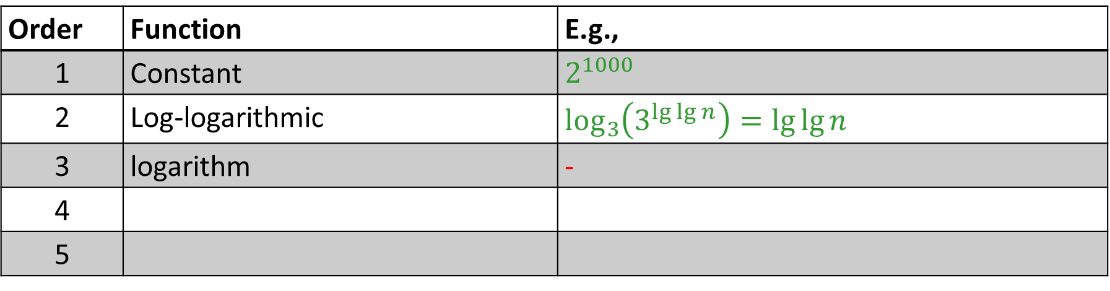
Classes of functions
$$10n\lg{n+5n, { 2}^{1000},{ 2}^{\lg{n}}, 50n+100\lg{n, \log_{3}\left(3^{\lg{\lg{n}}}\right), { n}^{0.5}, }}$$
$70n, 2^{n}, {\left(\lg{n}\right)}^{5}, n^{2}+100n, n^{3}, n\lg{n}$
Order | Function | E.g.,
1 | Constant | $$2^{1000}$$
2 | Log-logarithmic | $$\log_{3}\left(3^{\lg{\lg{n}}}\right)=\lg{\lg{n}}$$
3 | logarithm | -
4
5

Slide 37
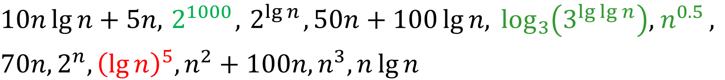
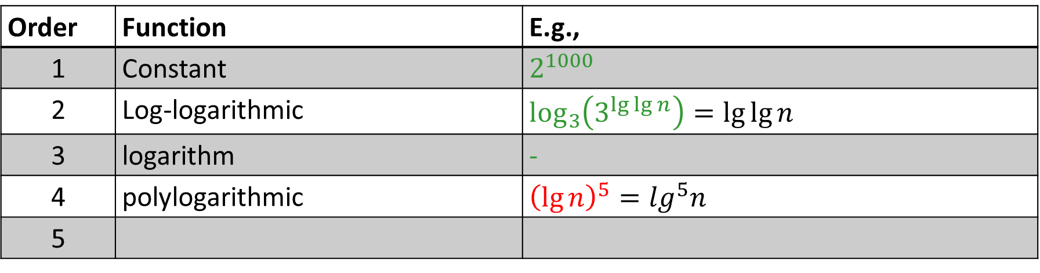
Classes of functions
$$10n\lg{n+5n, { 2}^{1000},{ 2}^{\lg{n}}, 50n+100\lg{n, \log_{3}\left(3^{\lg{\lg{n}}}\right), { n}^{0.5}, }}$$
$70n, 2^{n}, {\left(\lg{n}\right)}^{5}, n^{2}+100n, n^{3}, n\lg{n}$
Order | Function | E.g.,
1 | Constant | $$2^{1000}$$
2 | Log-logarithmic | $$\log_{3}\left(3^{\lg{\lg{n}}}\right)=\lg{\lg{n}}$$
3 | logarithm | -
4 | polylogarithmic | $${\left(\lg{n}\right)}^{5}=\lg^{5}n$$
5

Slide 38
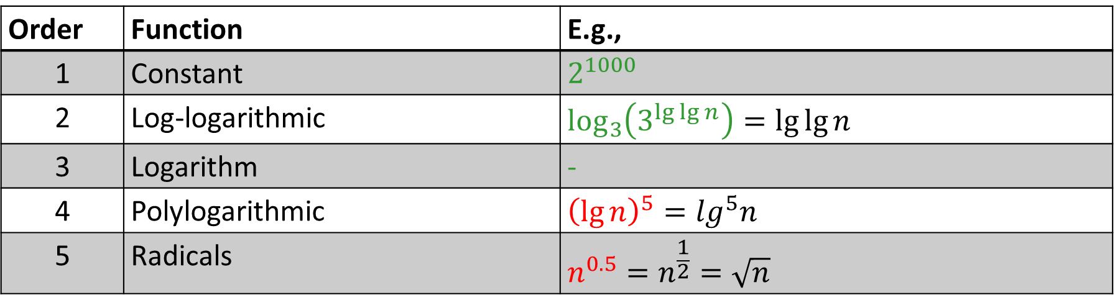
Classes of functions
$$10n\lg{n+5n, { 2}^{1000},{ 2}^{\lg{n}}, 50n+100\lg{n, \log_{3}\left(3^{\lg{\lg{n}}}\right), { n}^{0.5}, }}$$
$70n, 2^{n}, {\left(\lg{n}\right)}^{5}, n^{2}+100n, n^{3}, n\lg{n}$
Order | Function | E.g.,
1 | Constant | $$2^{1000}$$
2 | Log-logarithmic | $$\log_{3}\left(3^{\lg{\lg{n}}}\right)=\lg{\lg{n}}$$
3 | Logarithm | -
4 | Polylogarithmic | $${\left(\lg{n}\right)}^{5}=\lg^{5}n$$
5 | Radicals | $$n^{0.5}=n^{\frac{1}{2}}=\sqrt{n}$$

Slide 39
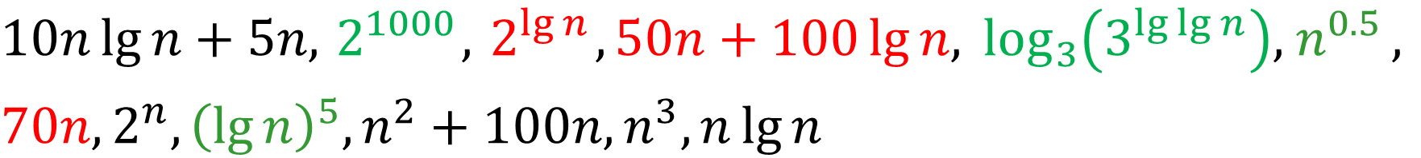
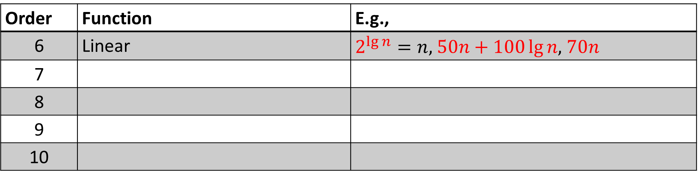
Classes of functions
$$10n\lg{n+5n, { 2}^{1000},{ 2}^{\lg{n}}, 50n+100\lg{n, \log_{3}\left(3^{\lg{\lg{n}}}\right), { n}^{0.5}, }}$$
$70n, 2^{n}, {\left(\lg{n}\right)}^{5}, n^{2}+100n, n^{3}, n\lg{n}$
Order | Function | E.g.,
6 | Linear | $2^{\lg{n}}=n,$ $50n+100\lg{n,}$ $70n$
7
8
9
10

Slide 40
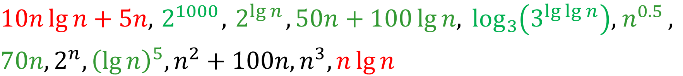
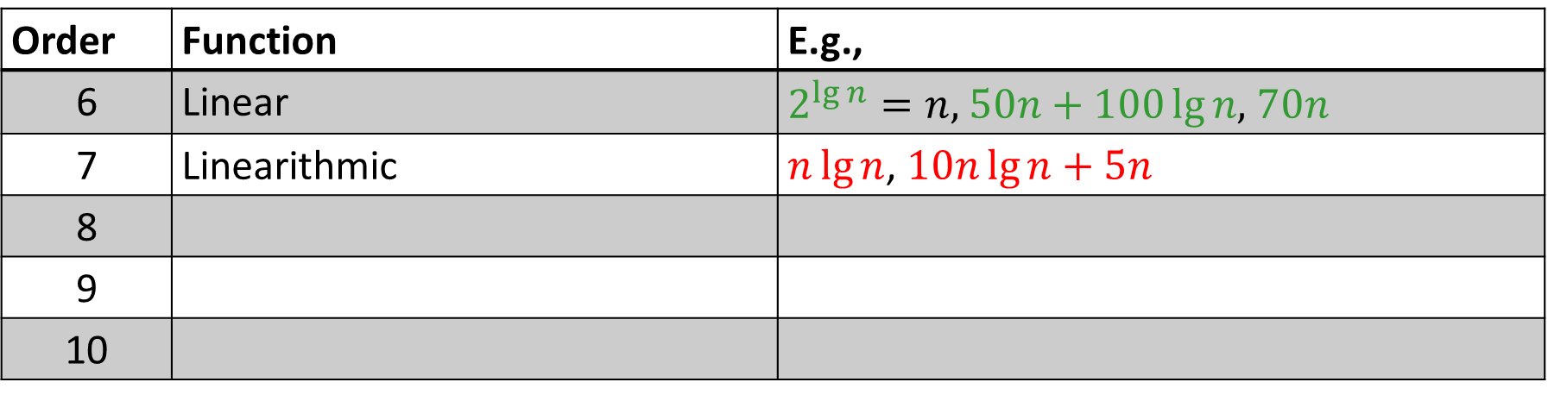
Classes of functions
$$10n\lg{n+5n, { 2}^{1000},{ 2}^{\lg{n}}, 50n+100\lg{n, \log_{3}\left(3^{\lg{\lg{n}}}\right), { n}^{0.5}, }}$$
$70n, 2^{n}, {\left(\lg{n}\right)}^{5}, n^{2}+100n, n^{3}, n\lg{n}$
Order | Function | E.g.,
6 | Linear | $2^{\lg{n}}=n,$ $50n+100\lg{n,}$ $70n$
7 | Linearithmic | $n\lg{n}$, $10n\lg{n+5n}$
8
9
10

Slide 41
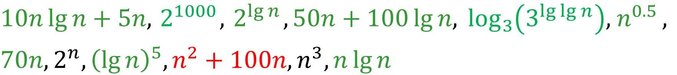
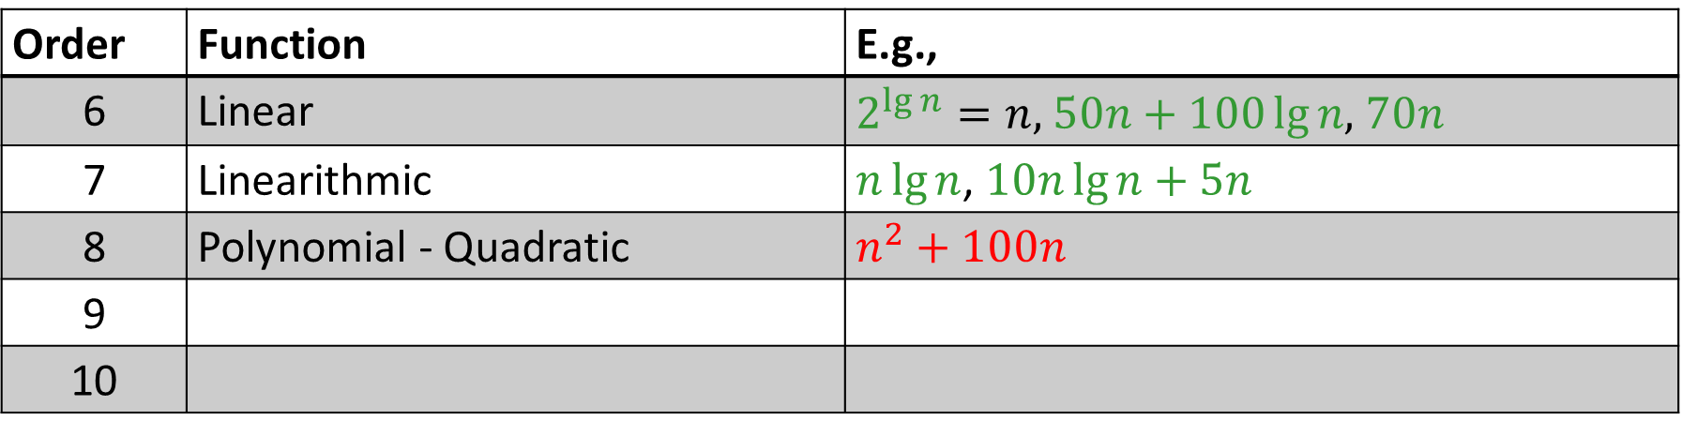
Classes of functions
$$10n\lg{n+5n, { 2}^{1000},{ 2}^{\lg{n}}, 50n+100\lg{n, \log_{3}\left(3^{\lg{\lg{n}}}\right), { n}^{0.5}, }}$$
$70n, 2^{n}, {\left(\lg{n}\right)}^{5}, n^{2}+100n, n^{3}, n\lg{n}$
Order | Function | E.g.,
6 | Linear | $2^{\lg{n}}=n,$ $50n+100\lg{n,}$ $70n$
7 | Linearithmic | $n\lg{n}$, $10n\lg{n+5n}$
8 | Polynomial - Quadratic | $$n^{2}+100n$$
9
10

Slide 42
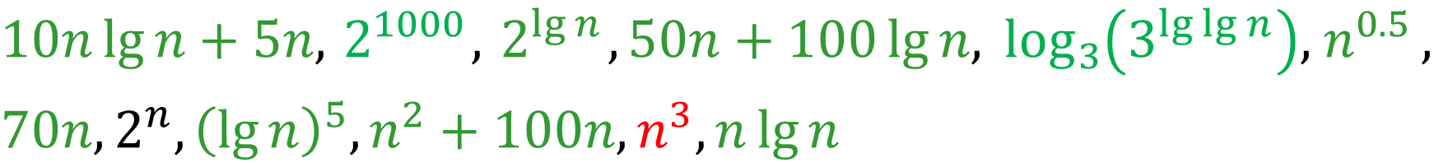
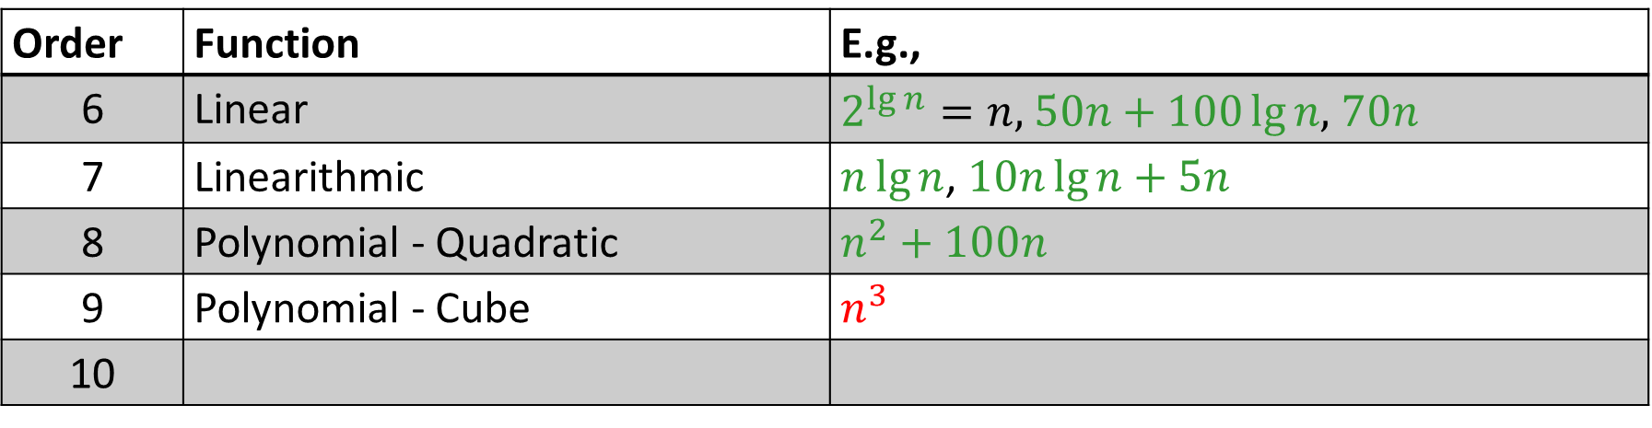
Classes of functions
$$10n\lg{n+5n, { 2}^{1000},{ 2}^{\lg{n}}, 50n+100\lg{n, \log_{3}\left(3^{\lg{\lg{n}}}\right), { n}^{0.5}, }}$$
$70n, 2^{n}, {\left(\lg{n}\right)}^{5}, n^{2}+100n, n^{3}, n\lg{n}$
Order | Function | E.g.,
6 | Linear | $2^{\lg{n}}=n,$ $50n+100\lg{n,}$ $70n$
7 | Linearithmic | $n\lg{n}$, $10n\lg{n+5n}$
8 | Polynomial - Quadratic | $$n^{2}+100n$$
9 | Polynomial - Cube | $$n^{3}$$
10

Slide 43
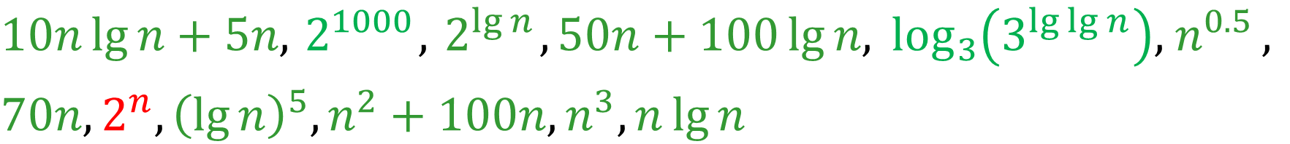
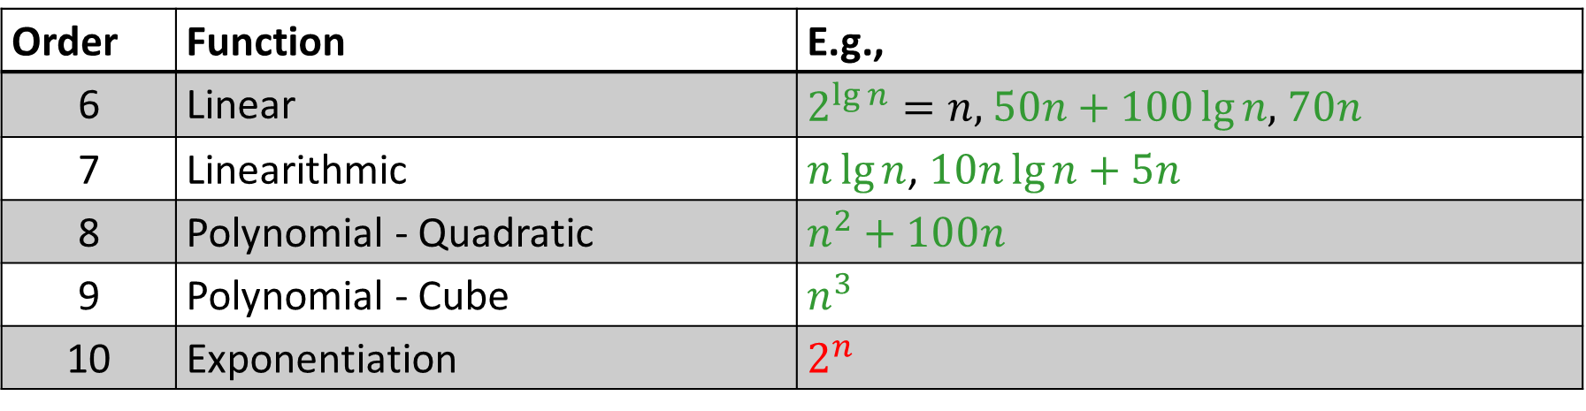
Classes of functions
$$10n\lg{n+5n, { 2}^{1000},{ 2}^{\lg{n}}, 50n+100\lg{n, \log_{3}\left(3^{\lg{\lg{n}}}\right), { n}^{0.5}, }}$$
$70n, 2^{n}, {\left(\lg{n}\right)}^{5}, n^{2}+100n, n^{3}, n\lg{n}$
Order | Function | E.g.,
6 | Linear | $2^{\lg{n}}=n,$ $50n+100\lg{n,}$ $70n$
7 | Linearithmic | $n\lg{n}$, $10n\lg{n+5n}$
8 | Polynomial - Quadratic | $$n^{2}+100n$$
9 | Polynomial - Cube | $$n^{3}$$
10 | Exponentiation | $$2^{n}$$

Slide 44
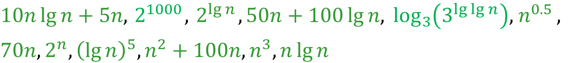
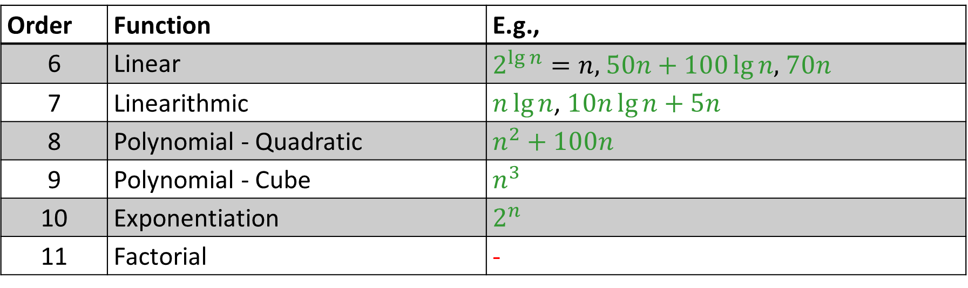
Classes of functions
$$10n\lg{n+5n, { 2}^{1000},{ 2}^{\lg{n}}, 50n+100\lg{n, \log_{3}\left(3^{\lg{\lg{n}}}\right), { n}^{0.5}, }}$$
$70n, 2^{n}, {\left(\lg{n}\right)}^{5}, n^{2}+100n, n^{3}, n\lg{n}$
Order | Function | E.g.,
6 | Linear | $2^{\lg{n}}=n,$ $50n+100\lg{n,}$ $70n$
7 | Linearithmic | $n\lg{n}$, $10n\lg{n+5n}$
8 | Polynomial - Quadratic | $$n^{2}+100n$$
9 | Polynomial - Cube | $$n^{3}$$
10 | Exponentiation | $$2^{n}$$
11 | Factorial | -

Slide 45

Classes of functions
$$2^{1000},$$
$$\log_{3}\left(3^{\lg{\lg{n}}}\right),$$
$${\left(\lg{n}\right)}^{5},$$
$$n^{0.5},$$
$$2^{\lg{n}}, 50n+100\lg{n}, 70n,$$
$n\lg{n,}$ $10n\lg{n+5n, }$
$$n^{2}+100n,$$
$$n^{3},$$
$$2^{n}$$

